Slide 1




Tic-Tac-Toe AI: Optimal Decision-Making
Using Minimax Algorithm and Alpha-Beta Pruning
Md Hasibur Rahman- 1921543042
Sanjida Akter Sadia - 2121431042
Al Hasib Reshad - 2131062042
Sakila Anjum - 2131241042
Fariha Akter Resha - 2131934642
CSE - 440
Section: 01
Supervisor: Mohammad Shifat-E-Rabbi
Notes:
1.7.2013
1.7.2013
1
‹#›
‹#›

Slide 2
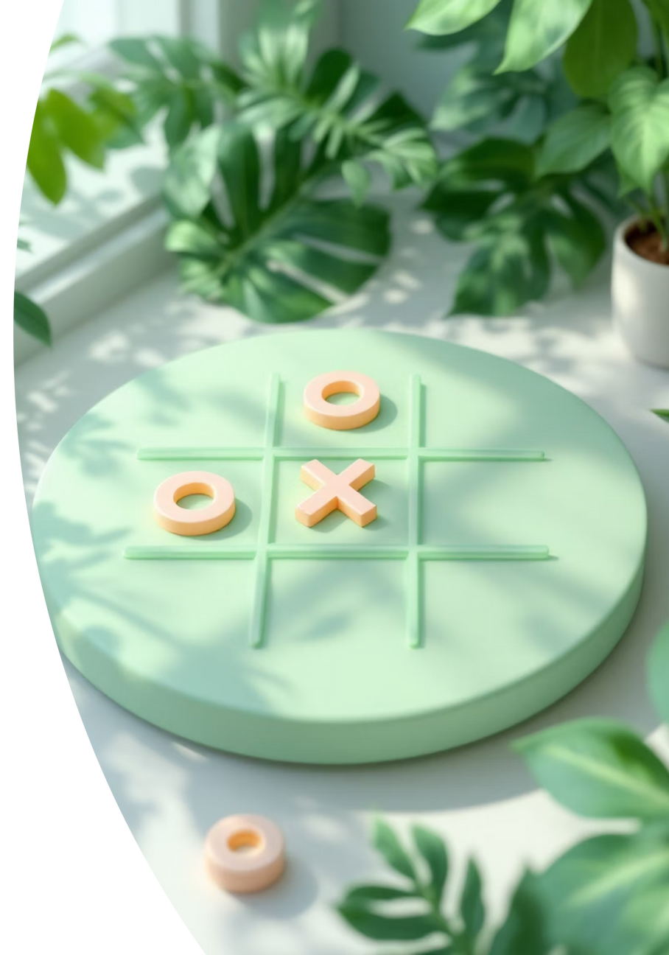


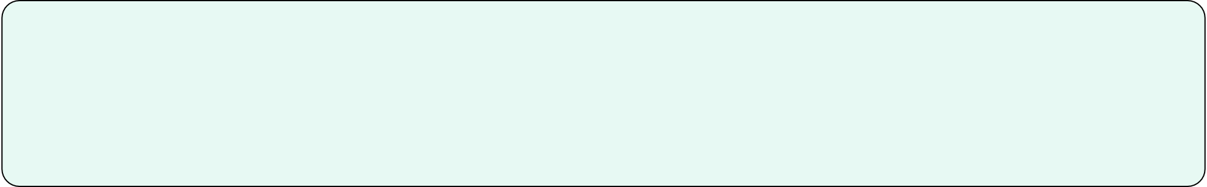



Introduction to Optimal AI Gameplay
Project Objective
To develop an optimal Tic-Tac-Toe AI capable of making perfect moves.
Core Algorithm
Utilizes the Minimax algorithm for strategic decision-making.
Efficiency Enhancement
Incorporates Alpha-Beta Pruning to significantly improve computational speed.
Heuristic Evaluation
Employs a heuristic system for faster, limited-depth gameplay.
Notes:
1.7.2013
1.7.2013
2
‹#›
‹#›

Slide 3
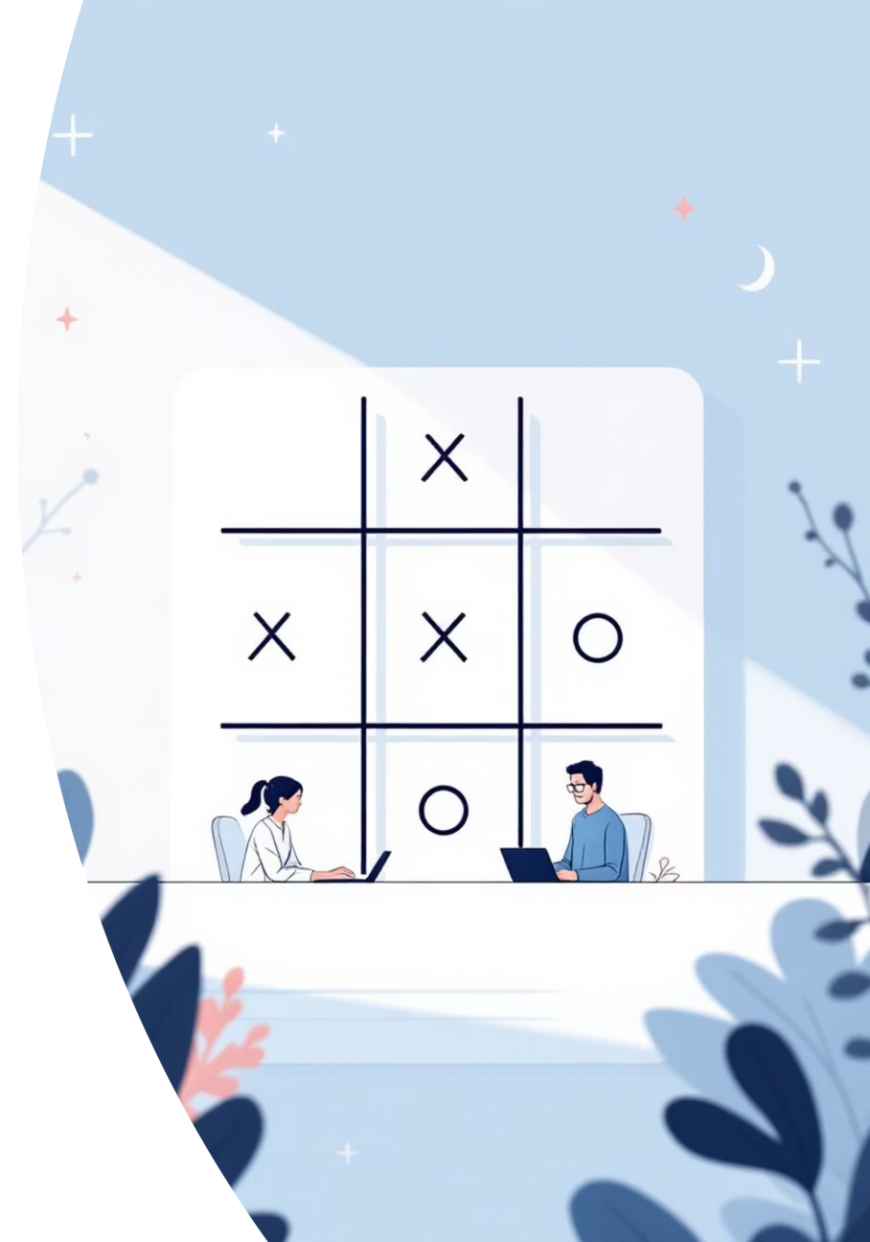
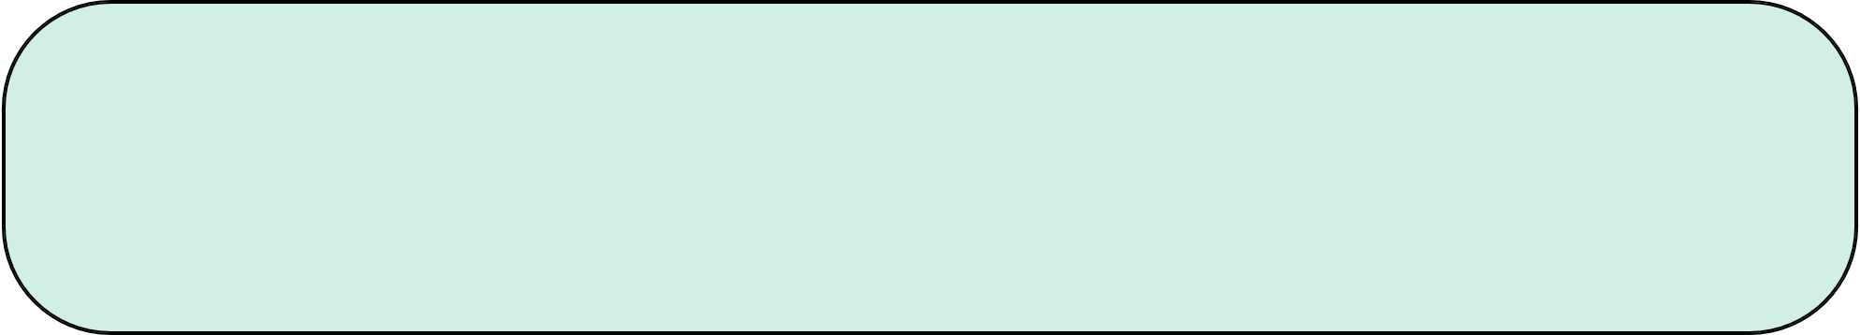
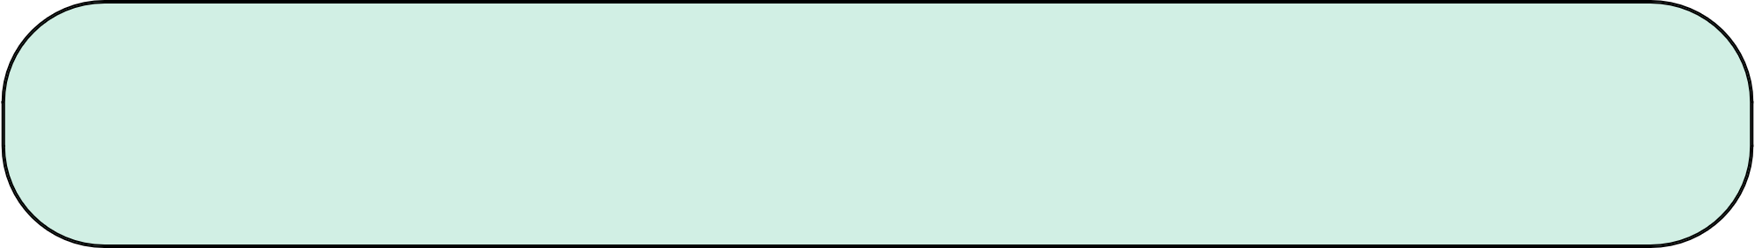

Why Tic-Tac-Toe is Perfect for AI Research
Simple Yet Strategic
Easy rules, deep tactical implications. An ideal sandbox for complex decision-making algorithms.
AI Testing Ground
Its finite states and clear win/loss conditions make it excellent for algorithm validation.
Turn-Based Structure
Naturally suited for game-theory algorithms like Minimax and Alpha-Beta Pruning.
Clear Performance Metrics
AI success is unambiguously defined by wins, losses, or draws.
Notes:
1.7.2013
1.7.2013
2
‹#›
‹#›

Slide 4

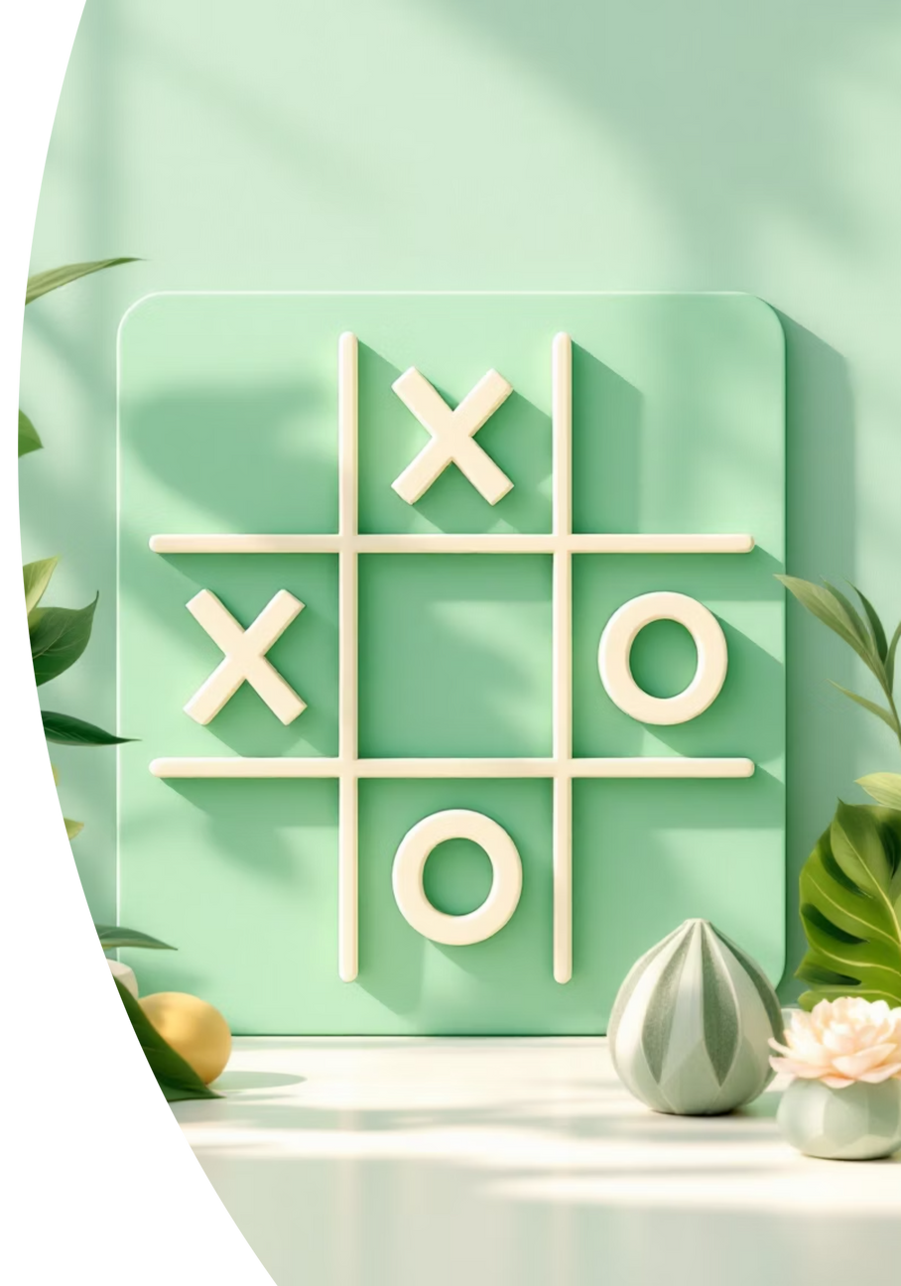

Methodology: Building the Optimal AI
Our approach to developing an unbeatable Tic-Tac-Toe AI integrates three core algorithmic components:
01
02
Minimax Algorithm
Alpha-Beta Pruning
The foundational decision-making process for optimal play in adversarial games.
An optimization technique to enhance the efficiency of the Minimax search.
03
Heuristic Evaluation
A scoring mechanism to assess game states when a full search isn't feasible, allowing for strategic depth.
Notes:
1.7.2013
1.7.2013
3
‹#›
‹#›

Slide 5
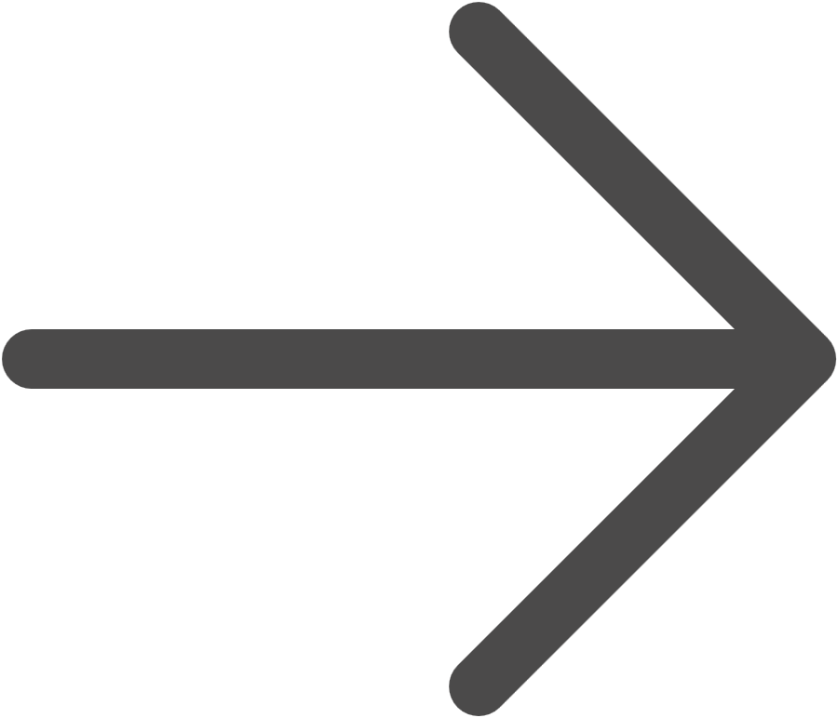
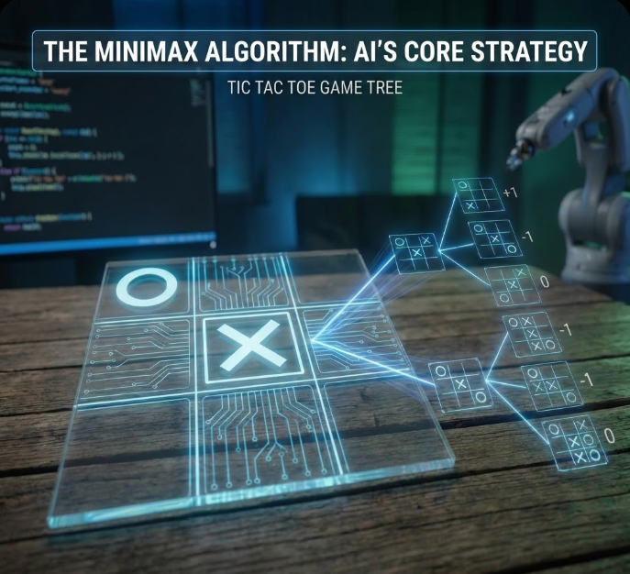
The Minimax Algorithm: AI's Core Strategy
Recursive Game-Tree Search
Minimax is a fundamental algorithm for two-player, zero-sum games, recursively exploring all possible moves to determine the optimal next step.
Player Roles Defined
The AI acts as the maximizer, aiming for the highest possible score, while the human opponent is the minimizer, seeking to achieve the lowest score for the AI.
Scoring System
+1: AI win
-1: Human win
0: Draw
Optimal Play Guarantee
The AI always selects the move that guarantees the best possible outcome, assuming perfect play from the opponent.
Notes:
1.7.2013
1.7.2013
4
‹#›
‹#›

Slide 6
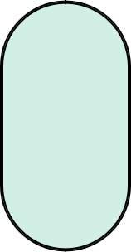
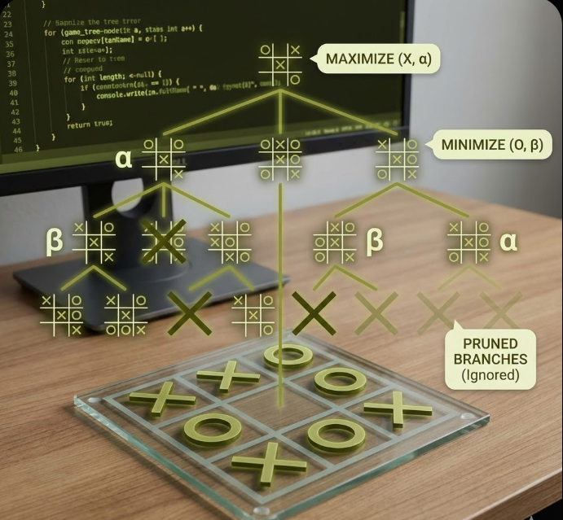
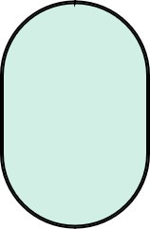
Alpha-Beta Pruning: Supercharging Minimax
Enhancing Efficiency
This optimization dramatically speeds up the Minimax algorithm by eliminating branches of the game tree that won't affect the final decision.
1
Alpha (α) Value
2
Represents the best score currently found for the maximizer (AI) along the current search path.
Beta (β) Value
3
Represents the best score currently found for the minimizer (human) along the current search path.
The Pruning Condition: α ≥ β
If the alpha value becomes greater than or equal to the beta value, the current branch can be 'pruned' because it won't lead to a better outcome for the maximizer.
4
Significant Performance Gain
Alpha-Beta Pruning can reduce the number of nodes examined by up to 75%, greatly decreasing computation time.
5
Notes:
1.7.2013
1.7.2013
5
‹#›
‹#›

Slide 7





Heuristic Evaluation: Strategic Insights for Partial Games
Heuristic evaluation functions are employed when a full Minimax search to the end of the game is computationally expensive or impossible. They assign a score to a non-terminal game state based on its potential for winning.
Scoring Unfinished Boards
Examples of Scoring
Benefits & Adaptability
+10: AI has two marks in a row with an open third spot.
Allows the AI to play strategically with limited search depth, blocking threats and creating opportunities. Scoring can be adjusted for varied difficulty levels.
Assigns values to board configurations based on potential outcomes, even before the game concludes.
-8: Opponent has two marks in a row with an open third spot.
Notes:
1.7.2013
1.7.2013
6
‹#›
‹#›

Slide 8

Implementation Overview: Python-Powered AI
Our Tic-Tac-Toe AI is implemented in Python, adhering to a modular design for clarity and maintainability.
⚬main.py: Manages the overall game loop and user interaction.
⚬tictaktoe_game.py: Handles board rendering and validates player moves.
⚬tictactoe_ai.py: Encapsulates all the AI's decision-making logic (Minimax, Alpha-Beta, Heuristics).
The game board is represented as a 1D list of 9 elements. The game loop orchestrates turns, displays the board, processes input, invokes the AI, and checks for game-ending conditions. Robust input handling ensures all user moves are legal and error-free.
Notes:
1.7.2013
1.7.2013
7
‹#›
‹#›

Slide 9
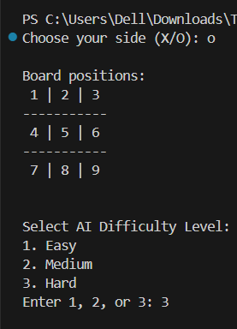
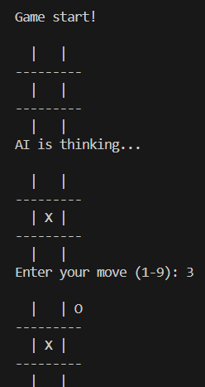
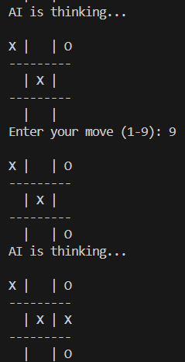
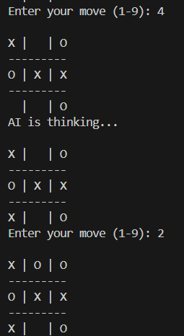
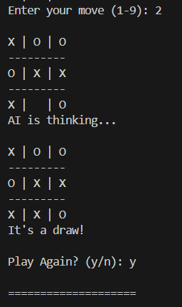
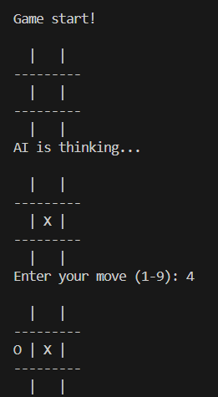
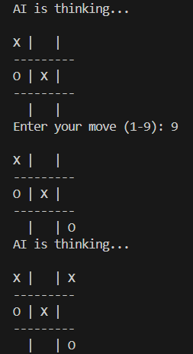
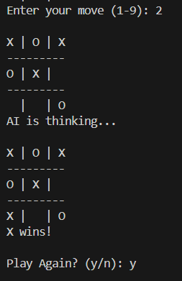
Output of TIC TAC TOE Game:
Notes:
1.7.2013
1.7.2013
7
‹#›
‹#›

Slide 10
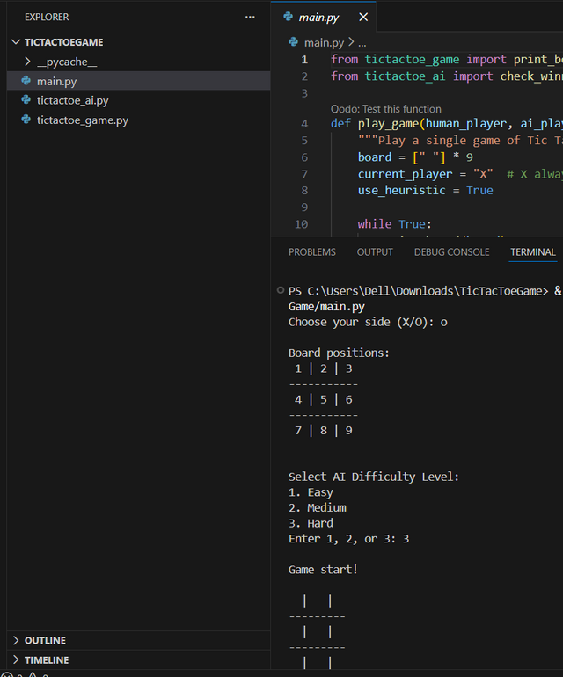
Outcomes of TIC TAC TOE Game:
AI Behavior Summary
The AI never loses when using full-depth Minimax.
It consistently blocks all threats and selects optimal winning moves.
If no winning path exists, the AI will force a guaranteed draw.
After each game ends:
➡ Start a new game
➡ Player chooses difficulty again
AI Difficulty Selection
Select AI Difficulty Level:
1️⃣ Easy
2️⃣ Medium
3️⃣ Hard
Notes:
1.7.2013
1.7.2013
7
‹#›
‹#›

Slide 11
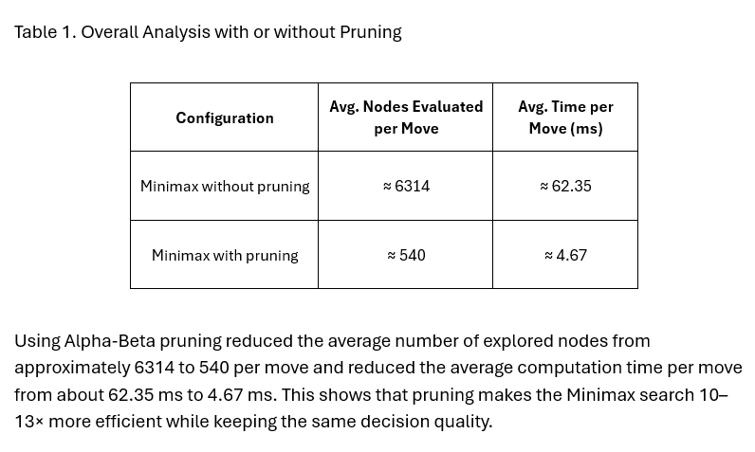
Performance of TIC TAC TOE Game:
Notes:
1.7.2013
1.7.2013
7
‹#›
‹#›

Slide 12
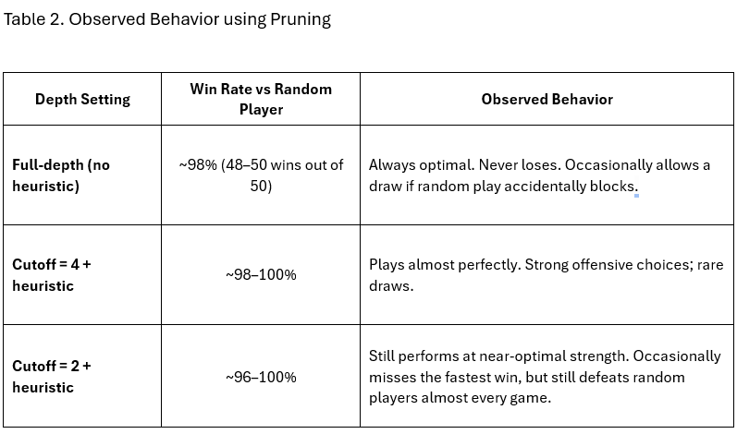
Performance of TIC TAC TOE Game:
Notes:
1.7.2013
1.7.2013
7
‹#›
‹#›

Slide 13


Conclusion: An Unbeatable AI
The developed AI proved to be an unbeatable opponent in Tic-Tac-Toe, consistently achieving optimal outcomes.
Guaranteed Optimal Play
1
Using full-depth Minimax, the AI consistently blocked threats and secured winning moves or forced a draw.
Enhanced Efficiency
2
Alpha-Beta Pruning significantly accelerated the AI's response time without compromising decision quality.
Strategic Adaptability
3
Heuristic evaluation allowed for strong play even in scenarios where a complete search was unnecessary or infeasible.
Maintainable Codebase
4
The modular design facilitated easy testing, debugging, and future updates to the project.
Notes:
1.7.2013
1.7.2013
8
‹#›
‹#›

Slide 14
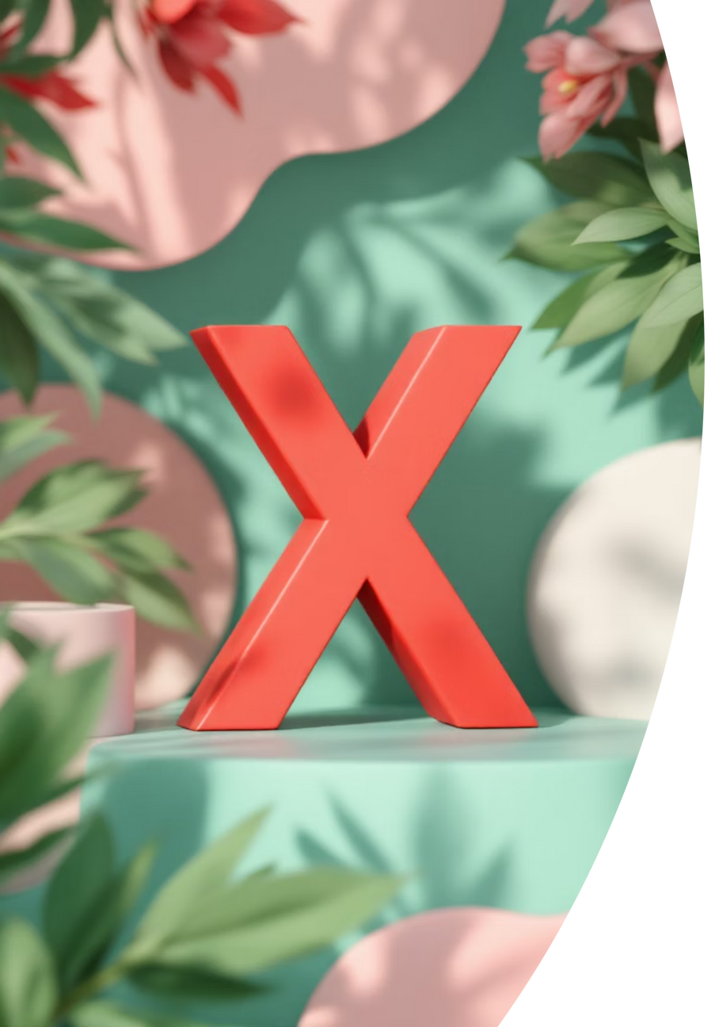
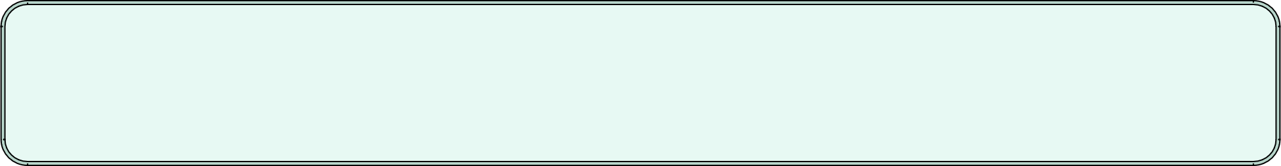
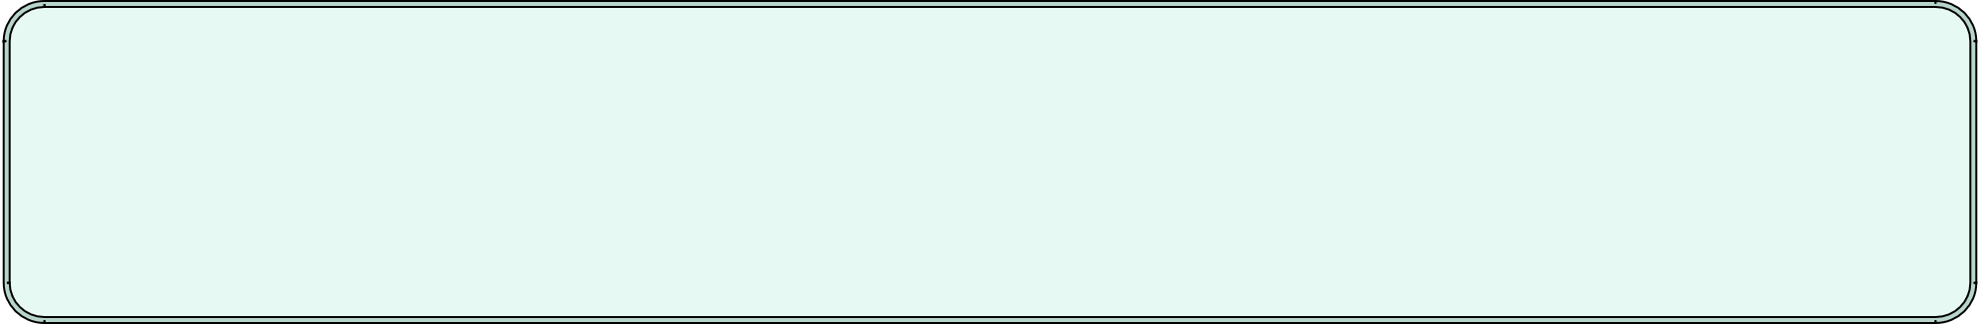
Identified Drawbacks and Limitations
No Learning Capability
The AI operates on predefined algorithms and does not learn or adapt from gameplay experience.
Fixed Board Size
Limited to a standard 3x3 grid; it cannot scale to larger game boards without significant modifications.
Lack of Graphical User Interface (GUI)
Currently text-based, lacking visual appeal and intuitive interaction.
Static & Predictable Behavior
Plays perfectly every time, offering no dynamic difficulty or variation, which can make it predictable for experienced players.
Notes:
1.7.2013
1.7.2013
9
‹#›
‹#›

Slide 15


Future Enhancements & Development Plan
Implement a Graphical User Interface (GUI)
Integrate frameworks like Tkinter or Pygame for a visually engaging and interactive experience with click-based gameplay.
AI Learning & Adaptation
Explore Q-learning or Reinforcement Learning to enable the AI to learn from its games and evolve its strategy dynamically.
Support for Larger Boards
Extend the game to 4x4 or 5x5 grids by optimizing Minimax with techniques such as Iterative Deepening or Monte Carlo Tree Search.
Performance Profiling
Utilize tools like Profile to identify bottlenecks and further optimize the AI's speed and efficiency.
Notes:
1.7.2013
1.7.2013
10
‹#›
‹#›

Slide 16

Notes:
1.7.2013
1.7.2013
10
‹#›
‹#›

